Slide 1
Lecture 11 Early Days of Bangladesh: Challenges and Prospects

Slide 2
OUTLINE: LECTURE 11
Early days of Bangladesh: Challenges and Prospects
Learning Objectives:
Understand the conditions of the war-ravaged country
Analyze the challenges of rebuilding the country
Explain the four basic principles of the Constitution and the reasons for their inclusion
Describe the salient features of the Constitution (1972)
Identify some of the major Amendments to the Constitution

Slide 3
TRIUMPHAL HOMECOMING
One of the momentous event of 1971 was the emergence of the new state, Bangladesh
The birth of Bangladesh was in many ways a unique phenomenon, for it was the first country to emerge out of a successful national liberation movement waged against "internal colonialism" in post-colonial states like Pakistan
Soon after 16 December 1971, the Bangladesh government-in-exile came back to Dhaka and established itself

Slide 4
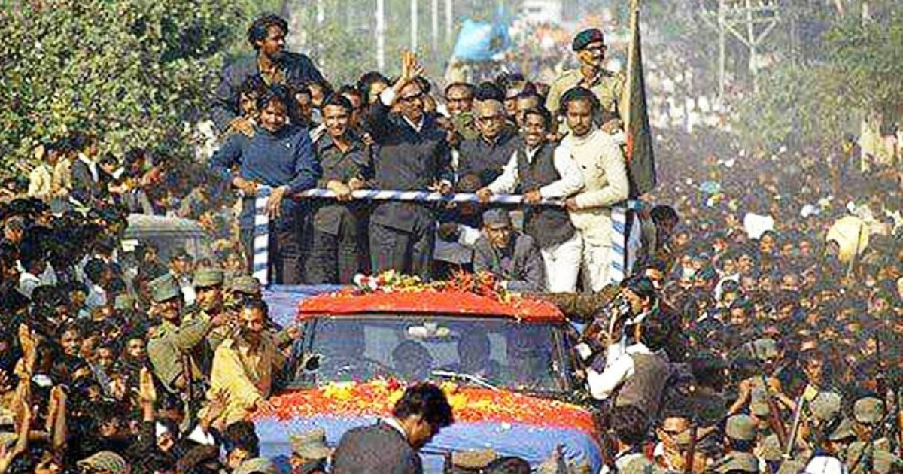
TRIUMPHAL HOMECOMING
The year 1972 started with the good news of Bangabandhu's imminent release
On 8 January Bangabandhu Sheikh Mujibur Rahman was released from a Pakistani prison and flown to London from where he returned to Bangladesh at 2:30 p.m. on 10 January

Slide 5
CHALLENGES OF NATION BUILDING
An overall estimate of the 1971 war might perhaps be nearer USD 2 billion (according to WB)
A World Bank report identified the challenges faced by independent Bangladesh:
All 10 million refugees had to be returned and resettled, with appropriate relief to get them through until the first harvest
Law and order had to be re-established – the situation aggravated by the ample supply of weapons left over from the war period

Slide 6
Surrender of Arms
On 17 January Bangabandhu called for the surrender of arms by the Mukti Bahini within a ten-day time limit
He reiterated his earlier belief that power does not come from the barrel of the gun but rather stems from the people
On 24 January he went to Tangail to preside over the ceremony of surrender of arms by Kader Siddiqui (nicknamed Tiger) and his men
In the next few days other groups of the Mukti Bahini surrendered their arms

Slide 7
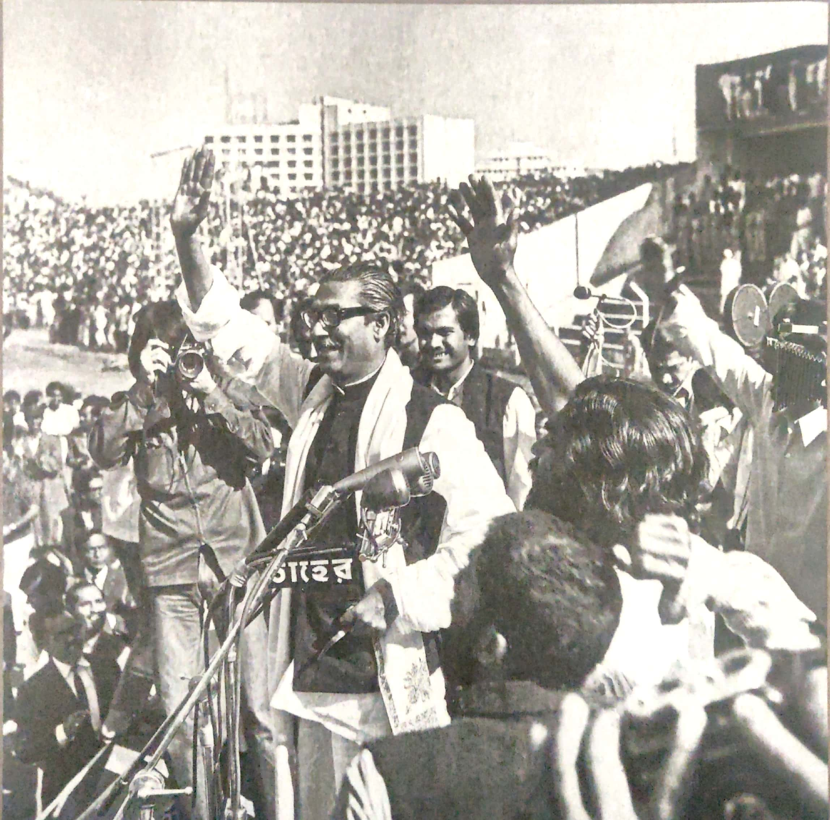
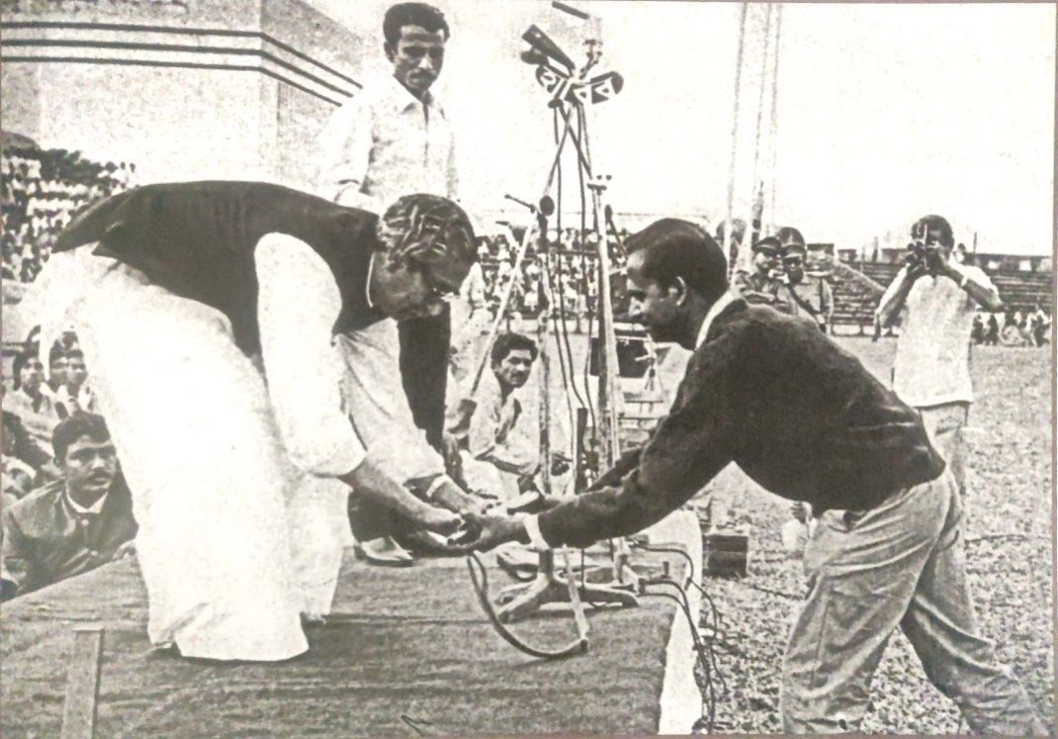
Surrender of Arms
Bangabandhu Sheikh Mujibur Rahman greeting the people gathered at the event of Freedom Fighters’ weapon submission in Dhaka Stadium (31 January 1972)
A freedom fighter submits his weapon to Bangabandhu Sheikh Mujibur Rahman at the Dhaka Stadium (31 January 1972)
https://www.youtube.com/watch?v=QfkyujihQE4&ab_channel=HTube

Slide 8
CHALLENGES OF NATION BUILDING
Even without the massive destruction of 1971, Bangladesh would have been an intolerably poor land, the result of centuries of exploitation
In 1969-70, the most recent normal year for Bangladesh, per capita annual income was taka 450
The structure of the economy was primitive, with large-scale economy contributing a mere 6% of the GDP
Nearly half the population had a deficiency in calorie intake, and the literacy rate was as low as 17%
While the economy was underdeveloped to begin with, the destruction incurred in 1971 was extensive

Slide 9
CHALLENGES OF NATION BUILDING
Agriculture sector was severely affected with immediate and substantial decline in production of rice, jute and tea
The physical infrastructure of the country was in ruins with ports and major bridges out of operations
In the industrial sector, the value of assets destroyed was estimated to be in millions of taka
Non-measurable consequences of the war, caused by the loss of raw materials and spare parts, lack of maintenance, transfer of monetary assets, departure of a number of top managers and skilled workers, and market disruptions were immense

Slide 10
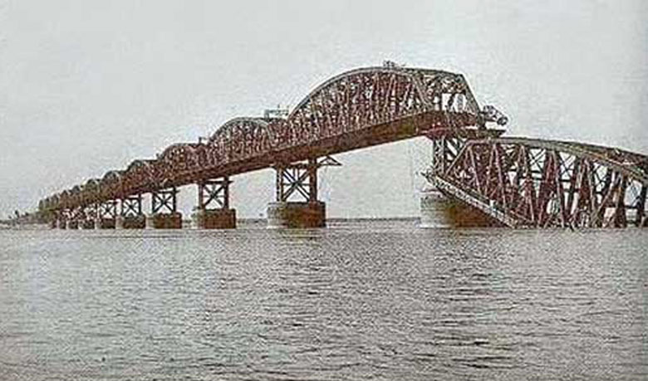
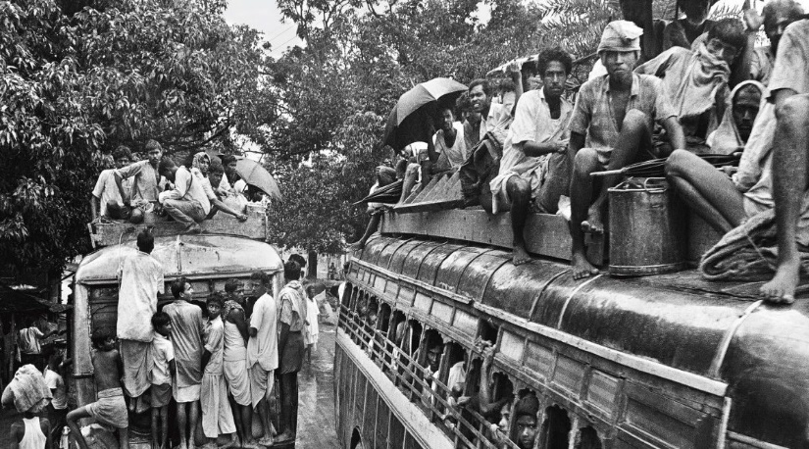
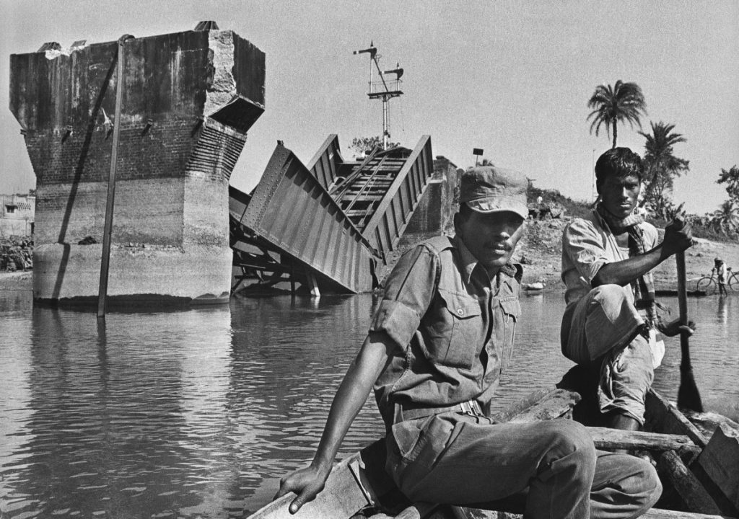
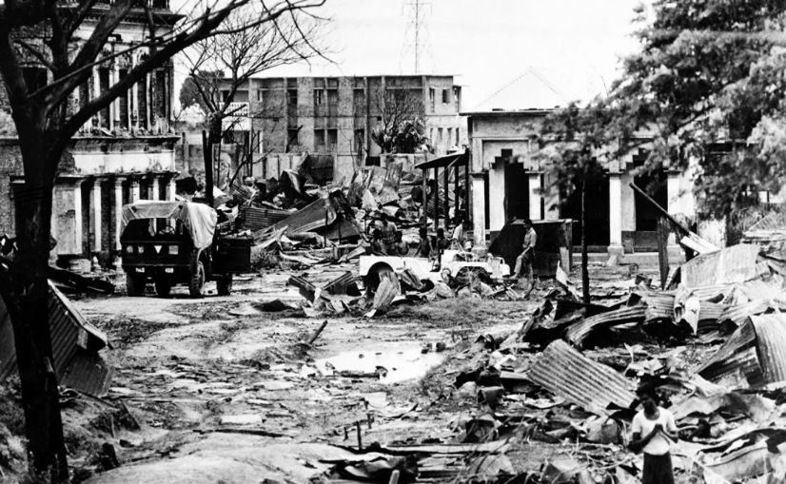
CHALLENGES OF NATION BUILDING
Collapse of Hardinge Bridge span caused by bombing during the 1971 Liberation War
Buses to rehabilitate the refugees
Destroyed Railway Bridge
Dacca in after the Liberation

Slide 11
CHALLENGES OF NATION BUILDING
Adequate supplies of food had to be obtained and distributed through the damaged transport system, to avert the threat of famine
The political and administrative structure had to be reconstituted and new institutions created to fill the gap left by the former Central government
The task of reconstruction had to be commenced and the economy restored to the pre-1971 level as quickly as possible

Slide 12
ACHIEVEMENTS
Nearly all refugees were resettled and a famine averted
In 1972 there was some shortfall in agricultural production, primarily due to drought but 2.27 million tons of Aus (আউশ ধান) crop was harvested
Industrial production made a fast recovery
Chittagong port was cleared and all damaged big bridges, with the exception of one, were repaired
Foreign exports were pushed up

Slide 13
ACHIEVEMENTS
Parallel to this, efforts were made to strengthen the different disciplinary forces like Police, BDR and Armed Forces
Bengali soldiers replaced Indian soldiers and took up responsibility of ensuring national security
Upon Bangabandhu’s discussion with Indian Prime Minister Indira Gandhi, all Indian troops were withdrawn from Bangladesh by March 1972
Civil administration was also slowly reinstituted
Within two months district officers were appointed in all the districts and a decision was taken to upgrade the subdivisions into district

Slide 14
MAKING OF THE CONSTITUTION
One of the great achievements of the government in its first twelve months in power was the successful completion of the task of constitution-making
On 23 March the Constitution Assembly Order was promulgated
On 10 April the Constituent Assembly met for two days and created a thirty-four member special committee headed by the Law Minister
The Constitution was drafted within six months
The Constituent Assembly met on 12 October and it passed the constitution bill on 4 November
The Constitution became effective on 16 December 1972 - exactly a year after the liberation of Bangladesh
It encapsulated the four fundamental principles of the state: democracy, nationalism, secularism, and socialism

Slide 15
FEATURES OF THE CONSTITUTION
The salient features of the 1972 Constitution included the introduction of a Westminster-type-parliamentary system
Parliament was vested with supreme authority on important issues like declaration of, or participation in war, and imposing and collecting taxes
It guaranteed the fundamental rights of the people and ensured the separation of the judiciary from the executive organ of the state

Slide 16
FEATURES OF THE CONSTITUTION
The constitution incorporates a number of provisions with an eye to ensure the stability of the system
Thus it stipulates that a member of parliament will lose her/his parliamentary seat when s/he loses party membership either because of resignation or expulsion from the party (Article 70)
It also provides that the prime minister can ask the president to dissolve the parliament and seek fresh elections when a vote of no confidence is passed against him, but it does make the parliament, rather than the court, the supreme authority in the state

Slide 17
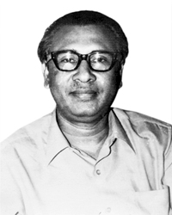

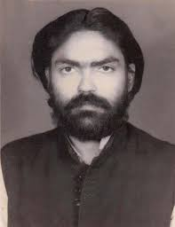
Political Leaders behind the Vail
Tajuddin Ahmed
Siraj Sikder
Surajul Alam Khan

Slide 18
Regimes In Independent Bangladesh
First Parliamentary Era
1972–1975: Sheikh Mujibur Rahman
Military Era
August–November 1975: Khondaker Mostaq Ahmad
1975–1981: Ziaur Rahman
1982–1990: Hussain Mohammad Ershad
Current Parliamentary Era
1991–1996: Khaleda Zia
1996–2001: Sheikh Hasina
2001–2006: Khaleda Zia
2006–2008: Caretaker government: Fakhruddin Ahmed
2009–2024: Sheikh Hasina
2024–Present: Interim Government: Muhammad Yunus

Slide 19
Reading Materials and Links to Videos
Video links:
Homecoming
https://youtu.be/WJPmMQM6u3k
Surrender of Arms
https://www.youtube.com/watch?v=QfkyujihQE4&ab_channel=HTube
Books:
1. The Bangladesh revolution and its aftermath By Talukder Moniruzzaman Dhaka: The University Press Limited, 1988), Chapter 8.
2. Ahmed, Moudud, Bangladesh: Era of Sheikh Mujibur Rahman (Dhaka: The University Press Limited, 1983), Chapter 1.
3. Jahan, Rounaq, “Bangladesh in 1972: Nation Building in a New State”, Asian Survey, Vol. 13, No. 2, February 1973, pp. 199–210. (Available at www.jstor.org/stable/2642736) .
4. Hossain, Kamal, Bangladesh: Quest for Freedom and Justice (Dhaka: The University Press Limited, 2013), Chapter 9 .

